Slide 1
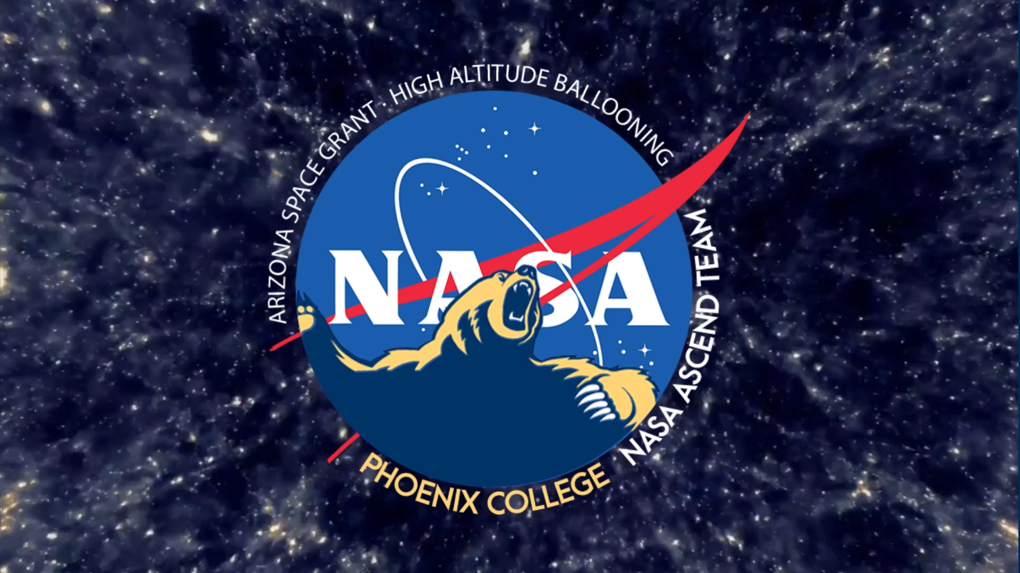

Slide 2



The Phoenix College Team
Mentors
Dr. Eddie Ong
Ernest Villicaña
Team Leaders
Ivan Gonzalez
Andrew Sherant
Mechanical
Andrew Sherant
Jacob Brannon
Javier Herrera
Video stabilization
Orion Martin
Lorynn Garcia
Advisor
Will Cohen
Atmospheric profiling
Dr. Eddie Ong
Collin Montgomery
Software & coding
Collin Montgomery
Michael Bittner
Rayan Alasow

Slide 3




Goals for 2022-2023 launches
Immersive 360° video and capture balloon rupture
Redundancy, modularity, and system independence
Measure radiation and atmospheric profiling

Slide 4
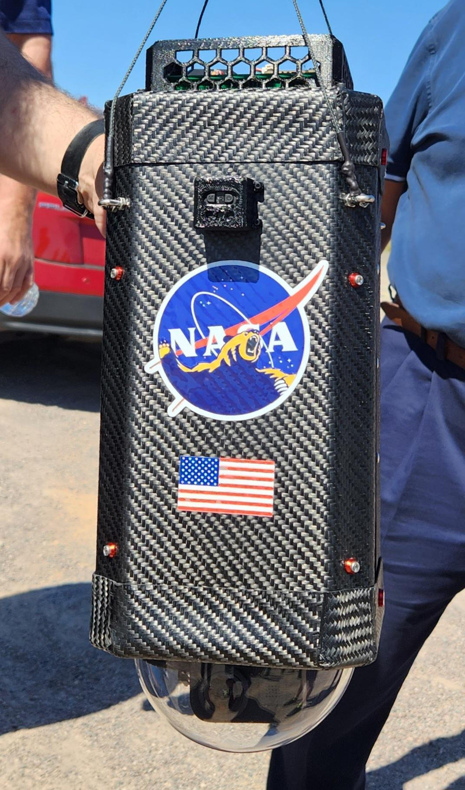
Payload Mechanical Design
Goals
Durability
Payload Survives Impact
Modularity
Allow Flexibility
Maintain Redundancy
Minimize Weight
Stress Testing
Methods and Materials
External Body
Carbon Fiber Composite
Internal Structure
3D Printed PETG and CF Nylon
Standardized Mounting Solution

Slide 5
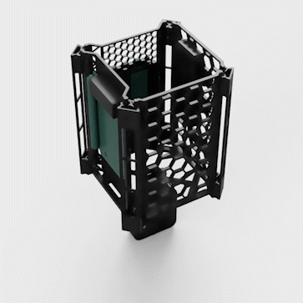
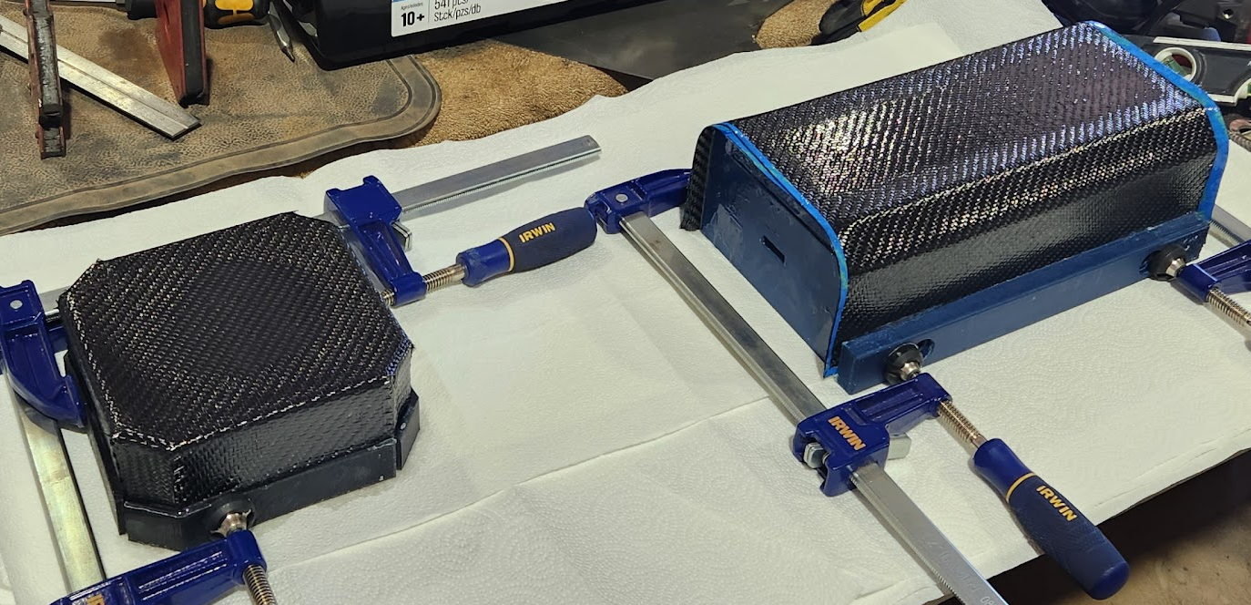
Fabrication
Body
New Molding System
Used new assy. hardware
Internals
Materials Testing
Custom Battery Housing

Slide 6
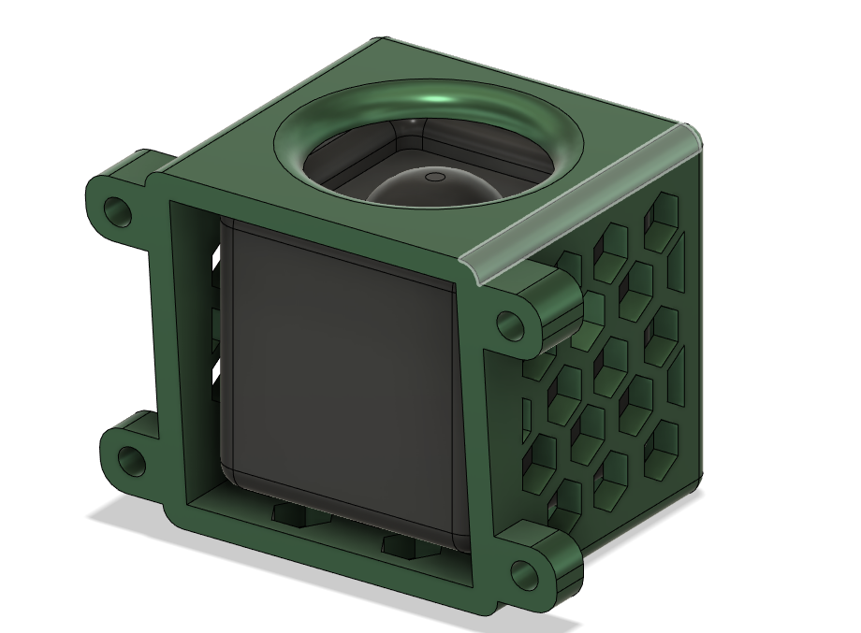
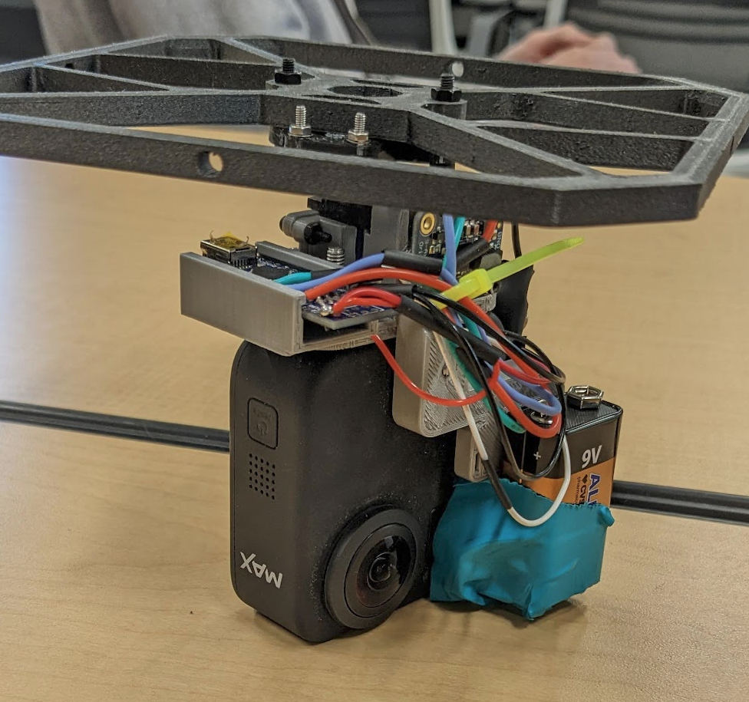
Video recording
Objectives
Stable and immersive 360° footage
Balloon rupture
Modular design
Independent power supply
Data acquisition
Methods
GoPro 360 Max and Cube cam
Software vs mechanical stabilization
Rail mounting
External Power Supply
Metadata from GoPro files
Notes:
Add photos to support methods ( of the gopro max and cube cam, the camera mounted on the octagon, the two power supplies that we built…)

Slide 7
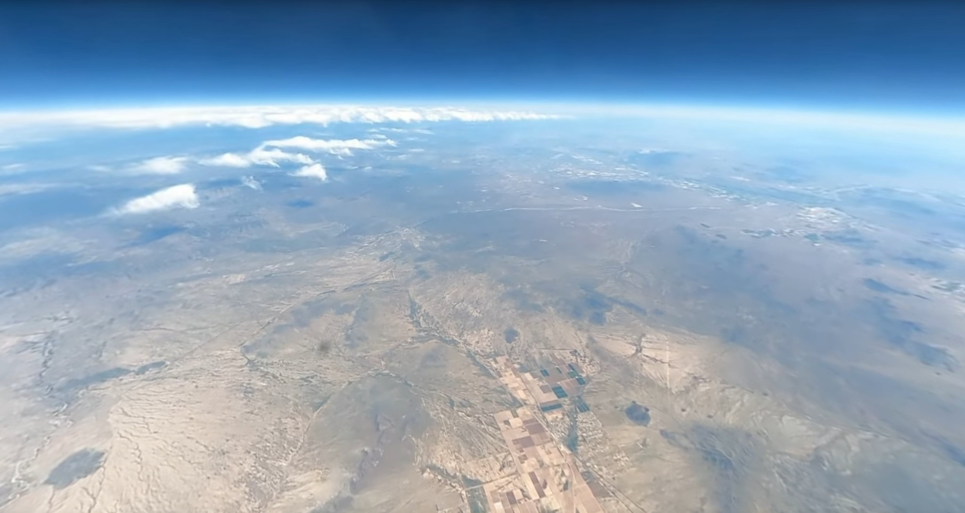
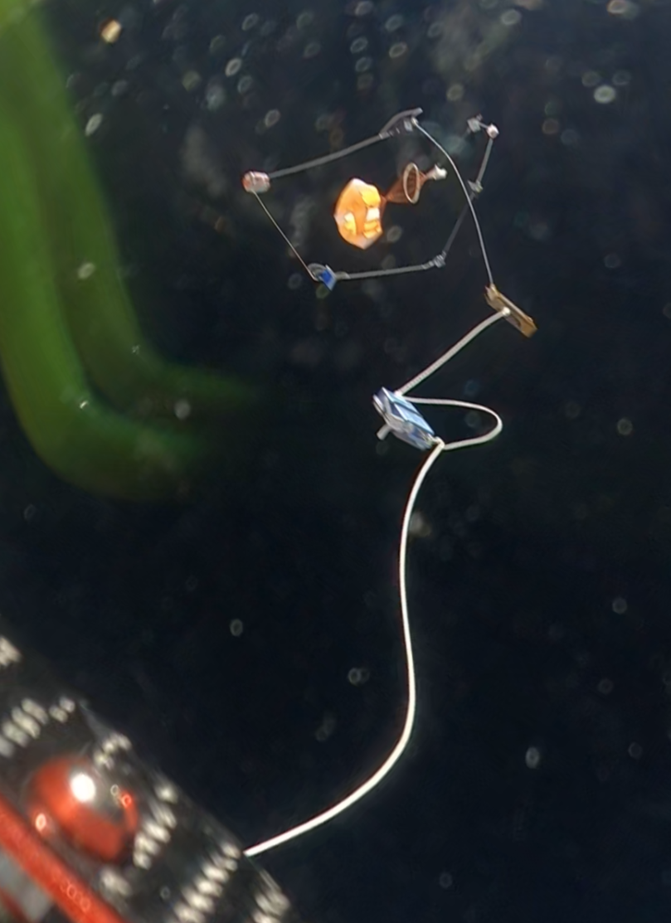
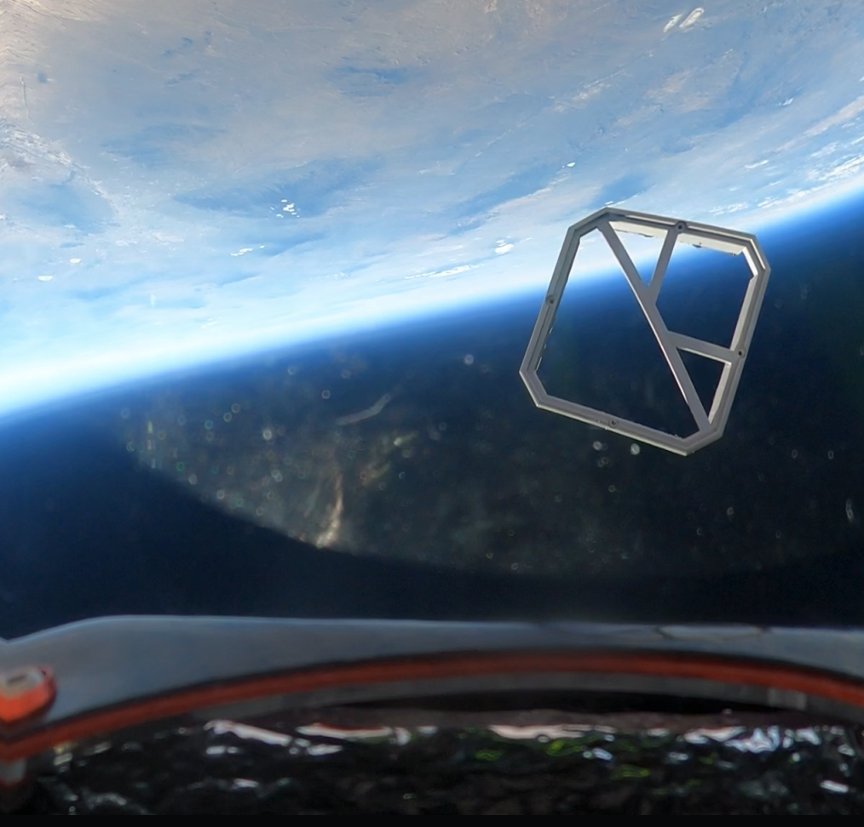

Video recording
Results
Complete fall ‘22 launch footage
Impressive Virtual Reality
Versatile camera module
Quickly serviceable
Motion data
Future goals
Use more reliable upward facing camera
Account for wear on batteries
Improve overall integration
Notes:
Add photo snippets of the footage (both semesters). Show motion data from both semesters (side to side comparison).

Slide 8
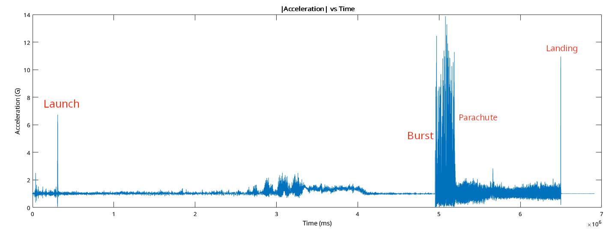
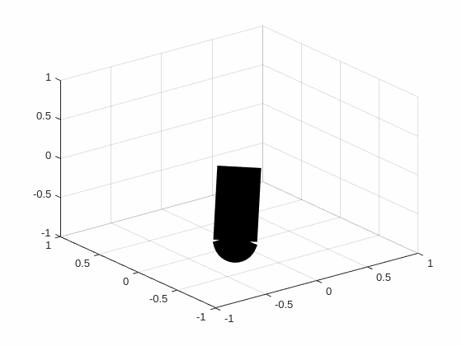
Data Visualization
Figure 1: spatial orientation
Figure 2: Total acceleration VS time
Notes:
Add photo snippets of the footage (both semesters). Show motion data from both semesters (side to side comparison).

Slide 9
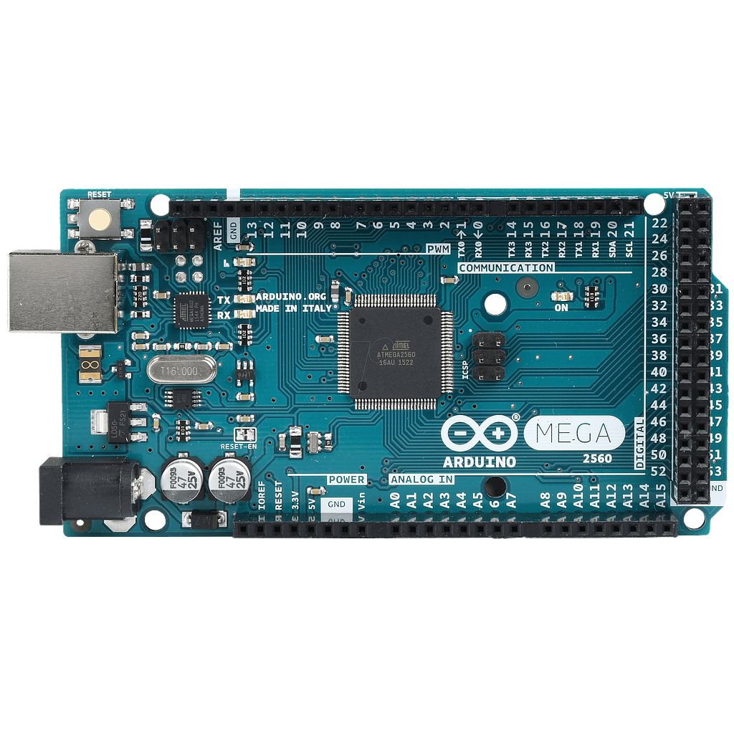
Software
Objective
Collect data from sensor package
Methods
Using C++, gather readings from various hardware sensors using an Arduino Mega
Notes:
should I delete all of the arduino symbols??

Slide 10
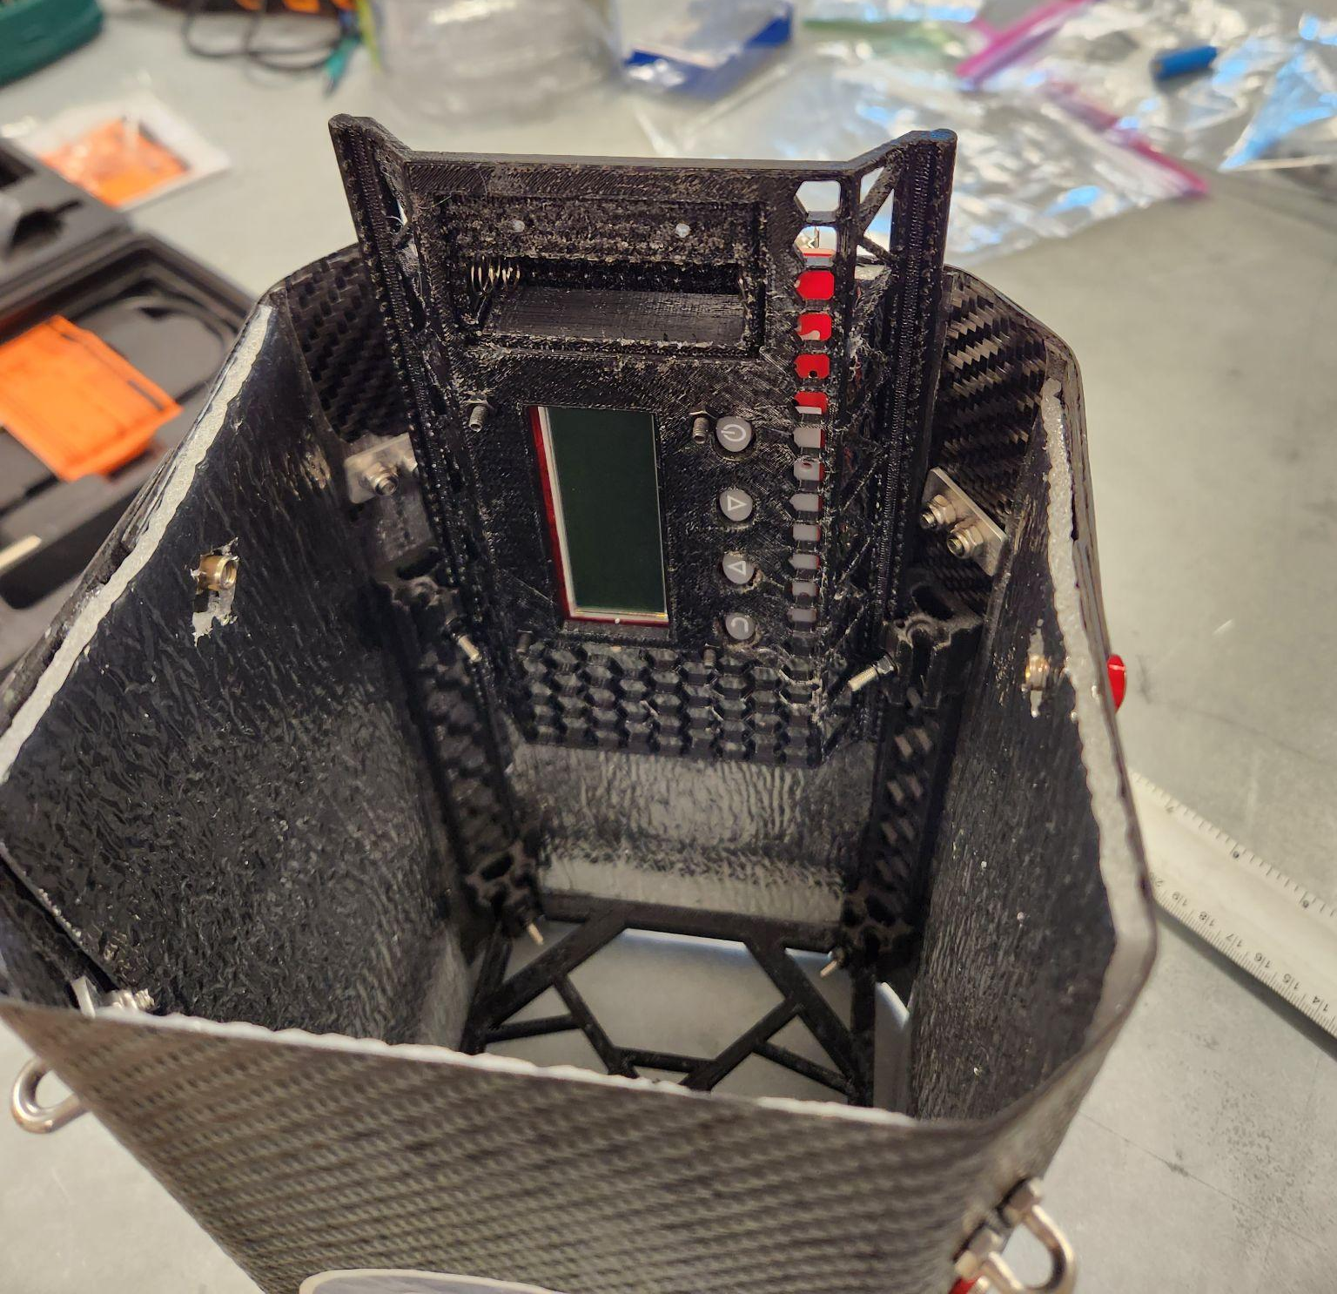
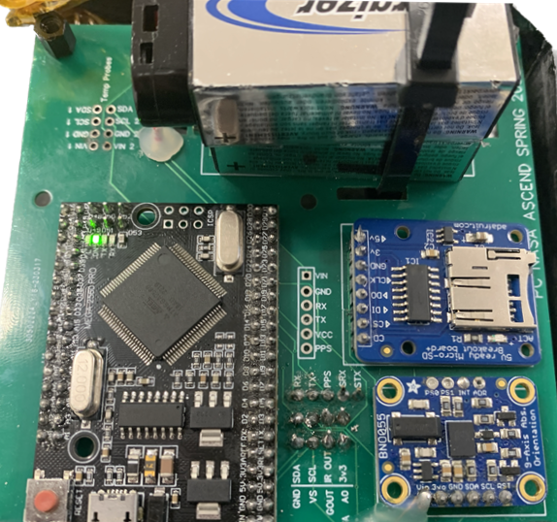
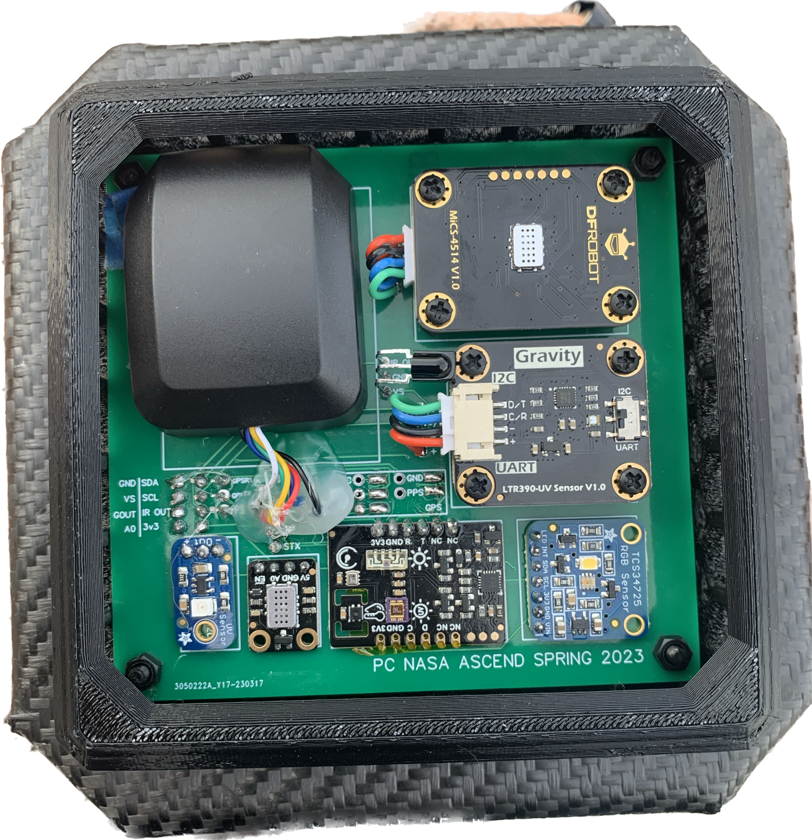
Atmospheric profiling
Objectives
Atmospheric data acquisition
Methods
Sensor array with arduino integration
GQ Geiger-Muller counter
MICS-4514
GPS
MEGA 2560 PRO
IR →
Adafruit MicroSD
Semester 1 results:
Data acquired until 9v was violently disconnected.
MICS2714
LTR390-UV
GUVA S12SD →
←TCS3472
Semester 2 results:
Data acquired until SD card ejection
BNO055
Fermion multi-sensor
Notes:
Include photos of sensor boards from our 2 semesters to talk about methods. Photos of modified sensors

Slide 11
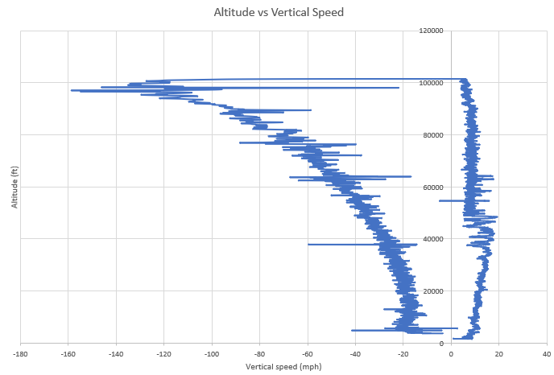
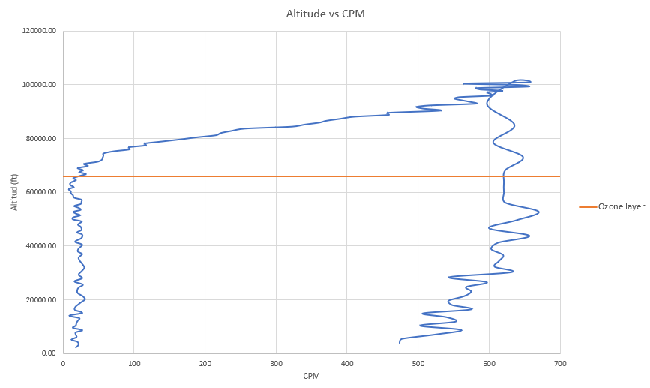
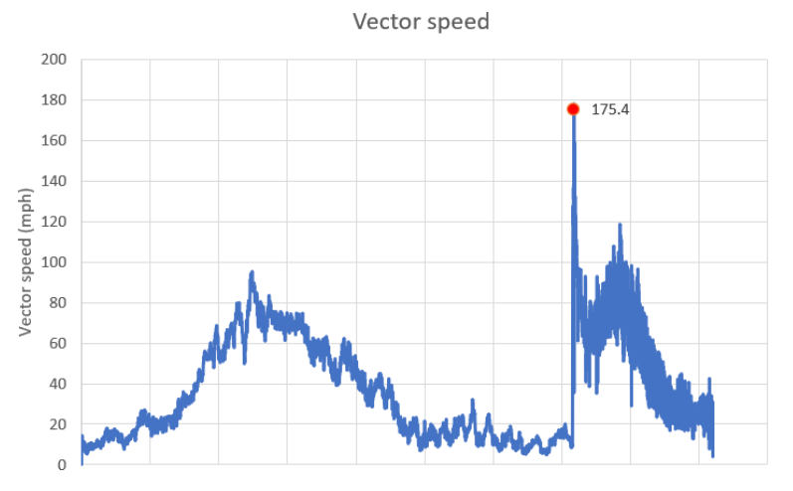
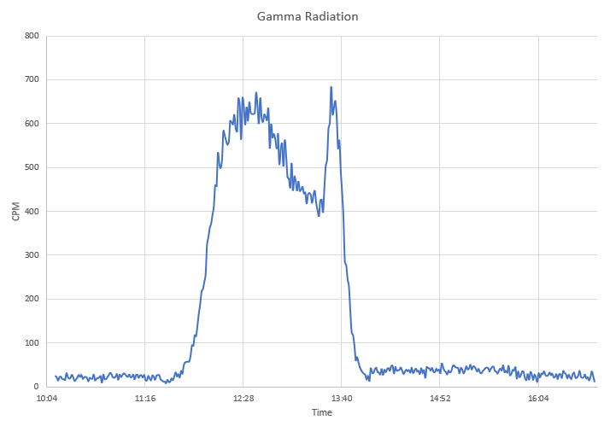
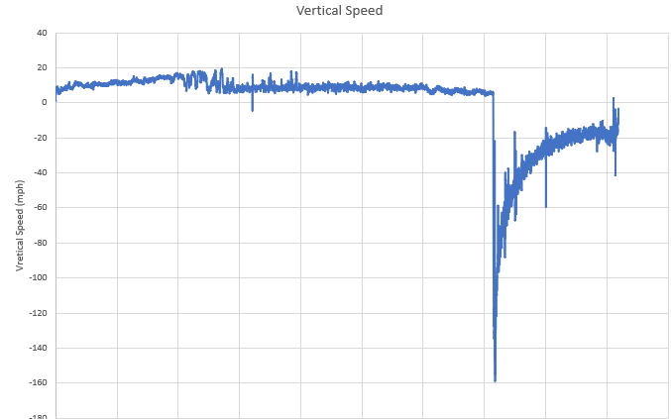
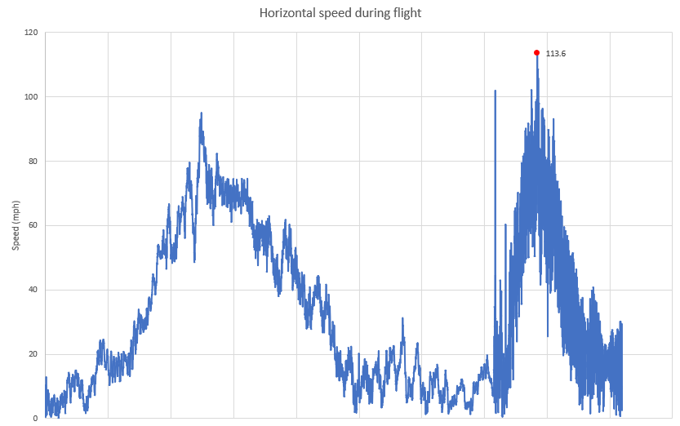
Atmospheric profiling
Results
Atmospheric data
Radiation data
SD card lost upon impact
Future goals
Secure SD card
Enclosure for inner board
Extended radiation analysis
*GPS and altitude data courtesy of ANSR
Notes:
Include graphs from atmospheric data, include photo of missing SD card and broken dome.

Slide 12
Lessons Learned
Mechanical
Modular system prevented failures and allowed flexibility
Significant weight saving
Software
Modular functions allowed for rapid debugging
Use better database backups in future
Atmospheric Profiling
Custom PCB allowed for compact sensor suite
Independent GC allowed for meaningful data collection
Use more robust SD card retention
Video Stabilization
GoPro 360 Max = amazing and stable VR experience and telemetry
Improve battery reliability in cold conditions

Slide 13
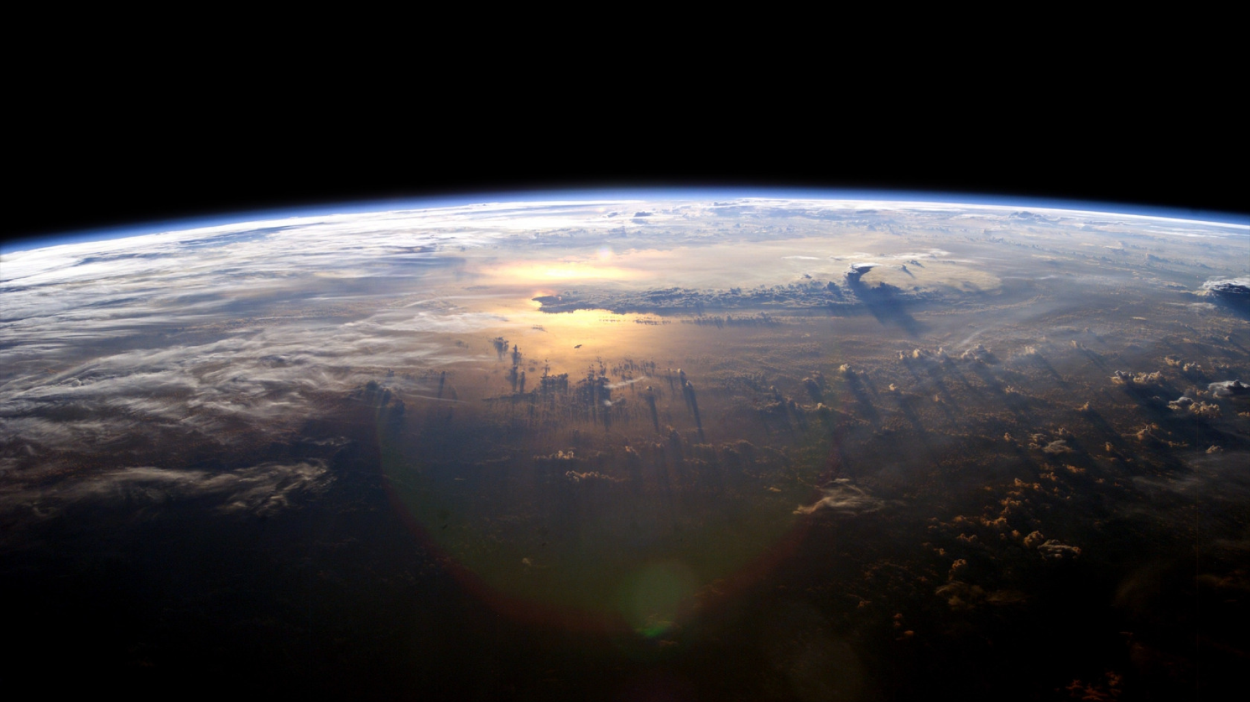

Acknowledgements
Michelle Coe
Shirley Campbell
Ernest Villicaña

Slide 14



Thank you!
PCNASAASCEND@gmail.com
@PCAscend
Notes:
The Fall 2022 Team

Slide 15
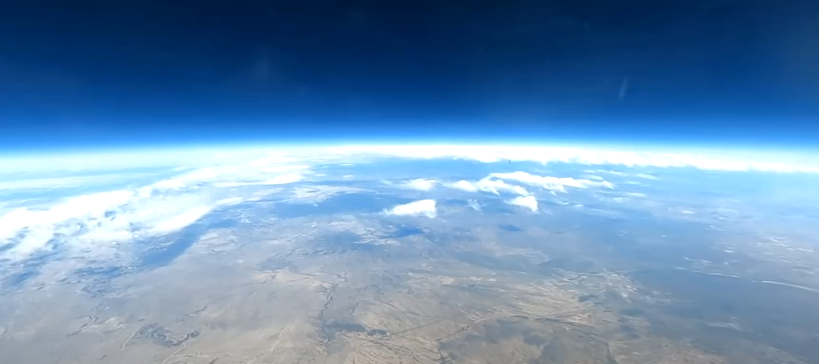
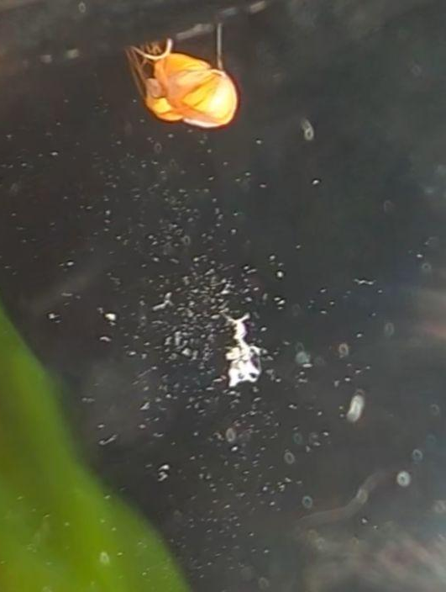
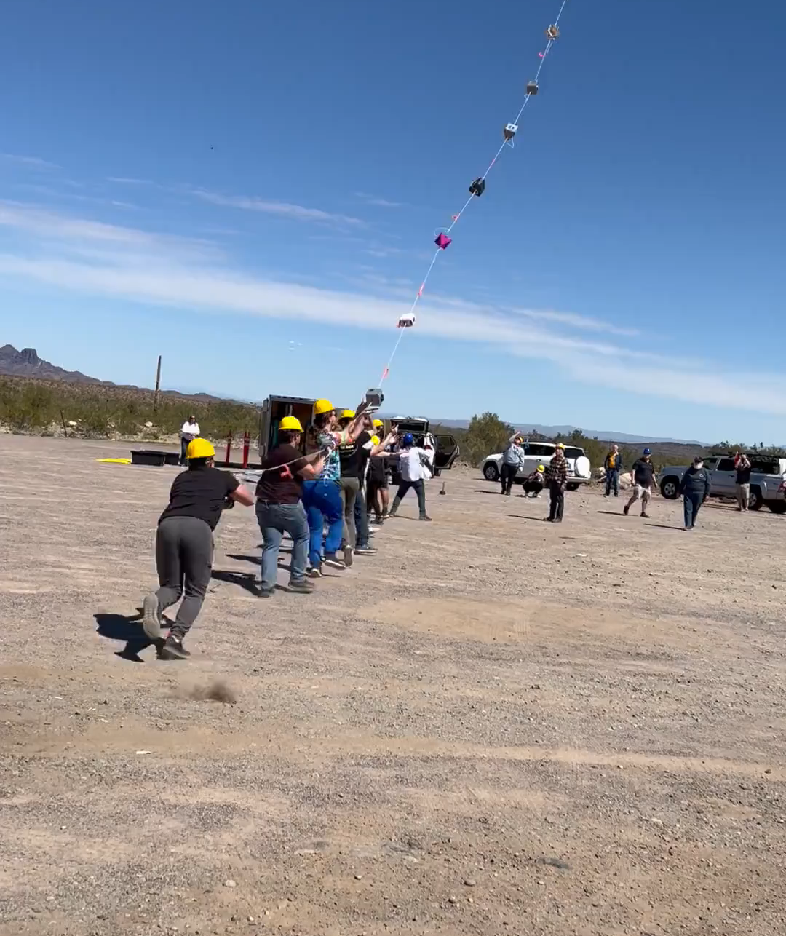
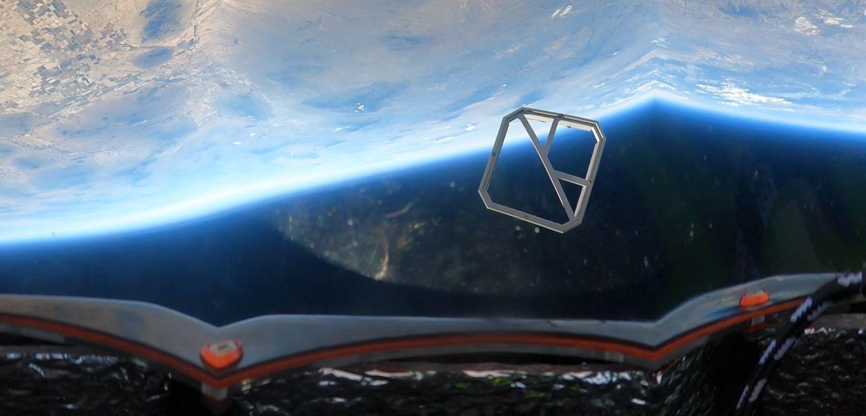
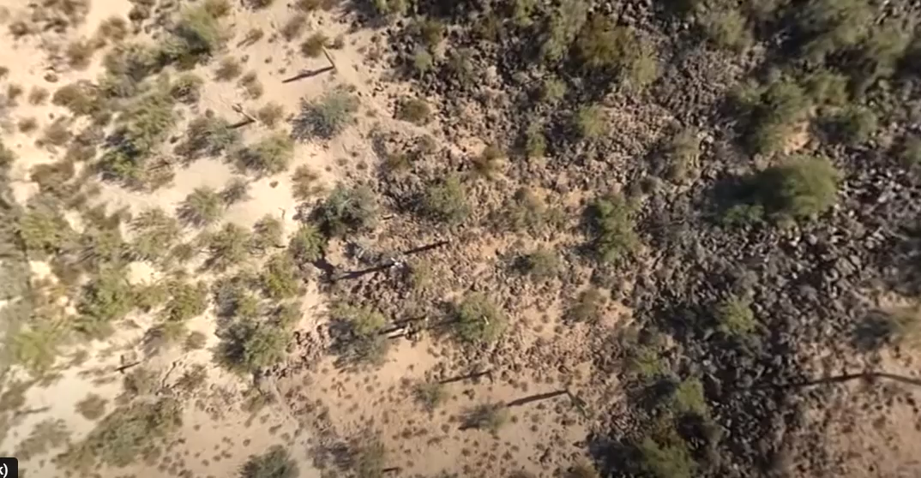
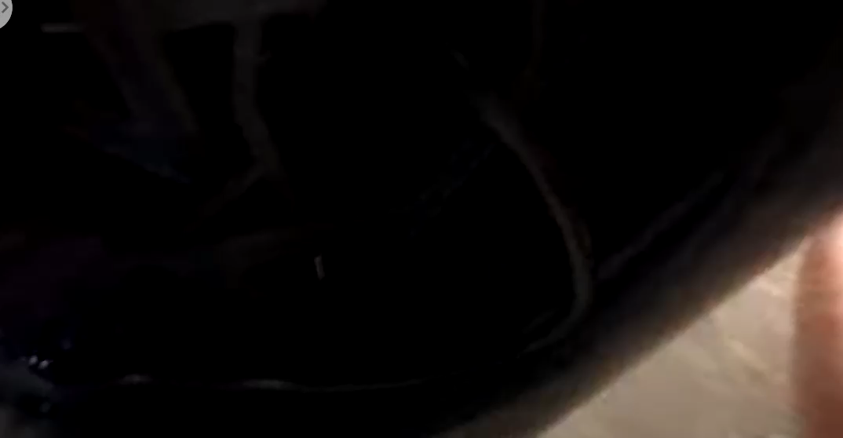
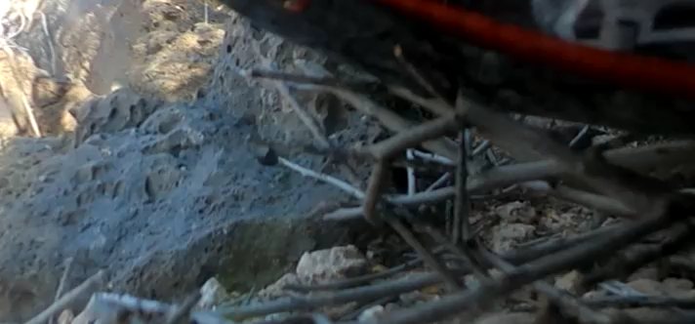
BEST FOOTAGE!
Notes:
The Fall 2022 Team

